Slide 1
Start with python …
Support Session 1
AUG

Slide 2


Agenda
A
Dictionaries
Sets

Slide 3
List vs Dictionary
List
Index | Element
0 | ‘Ann’
1 | ‘John’
Dictionary
Key | value
‘Ann’ | ‘B’
‘John’ | ‘A+’
Use an index to access a value
Index is an integer
Use an key to access a value
Key can be any immutable type

Slide 4
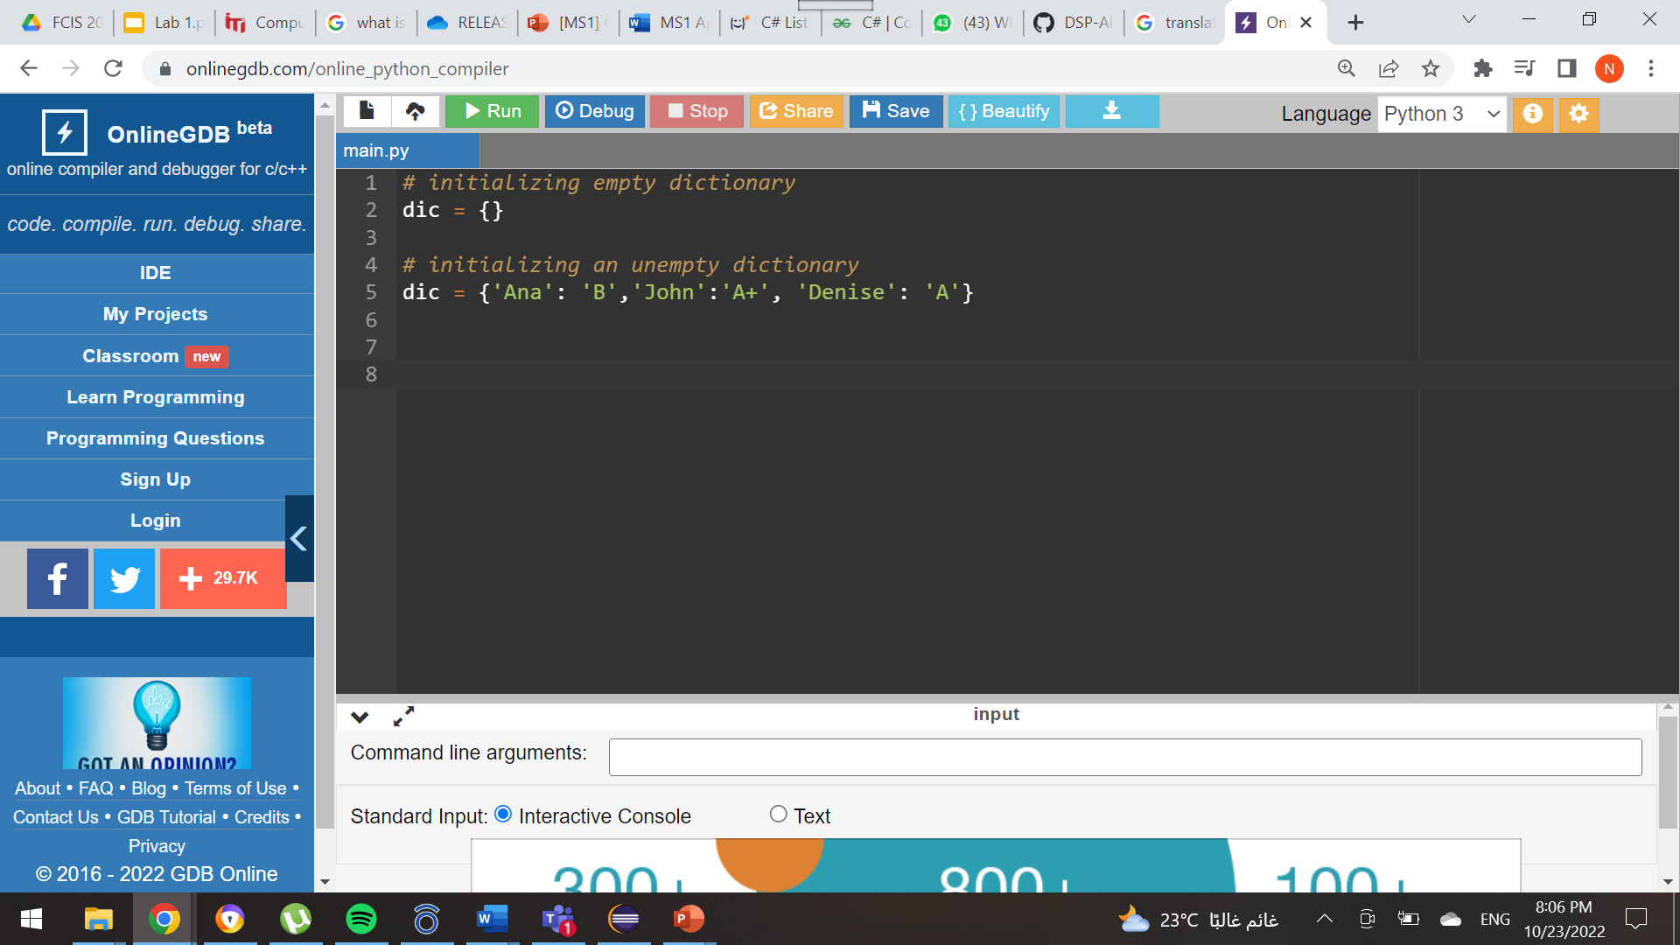
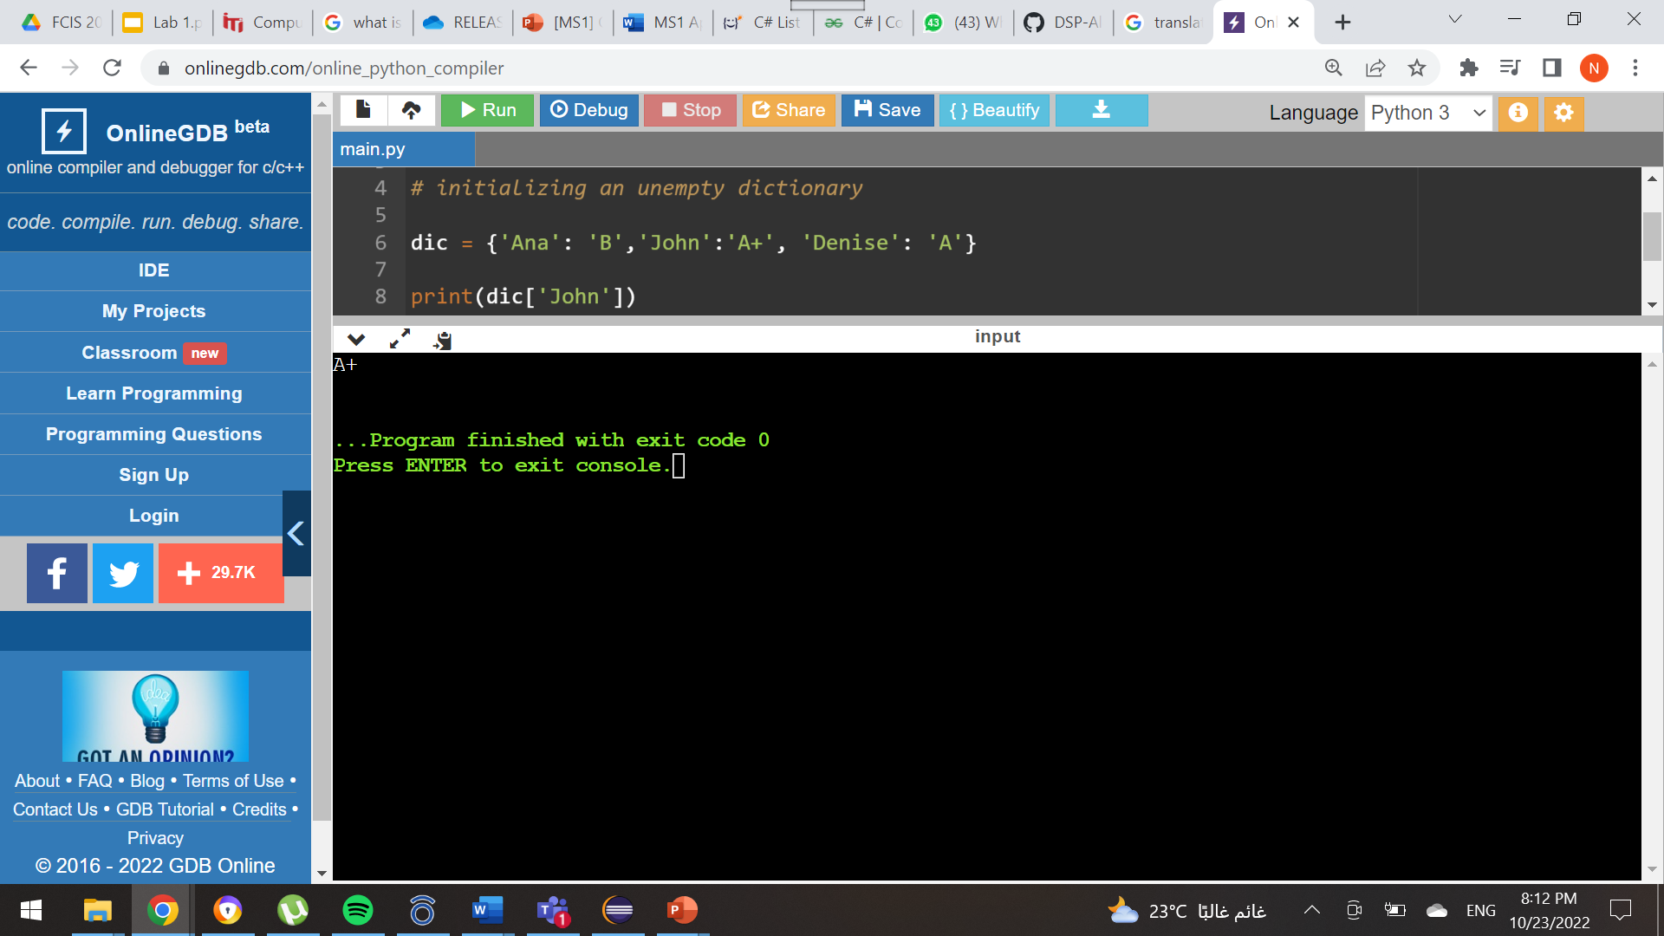
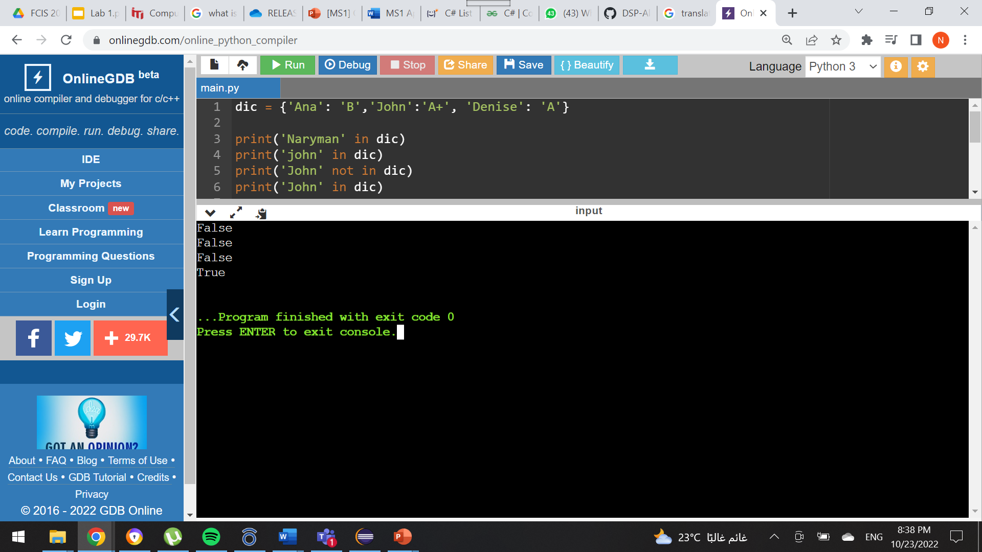
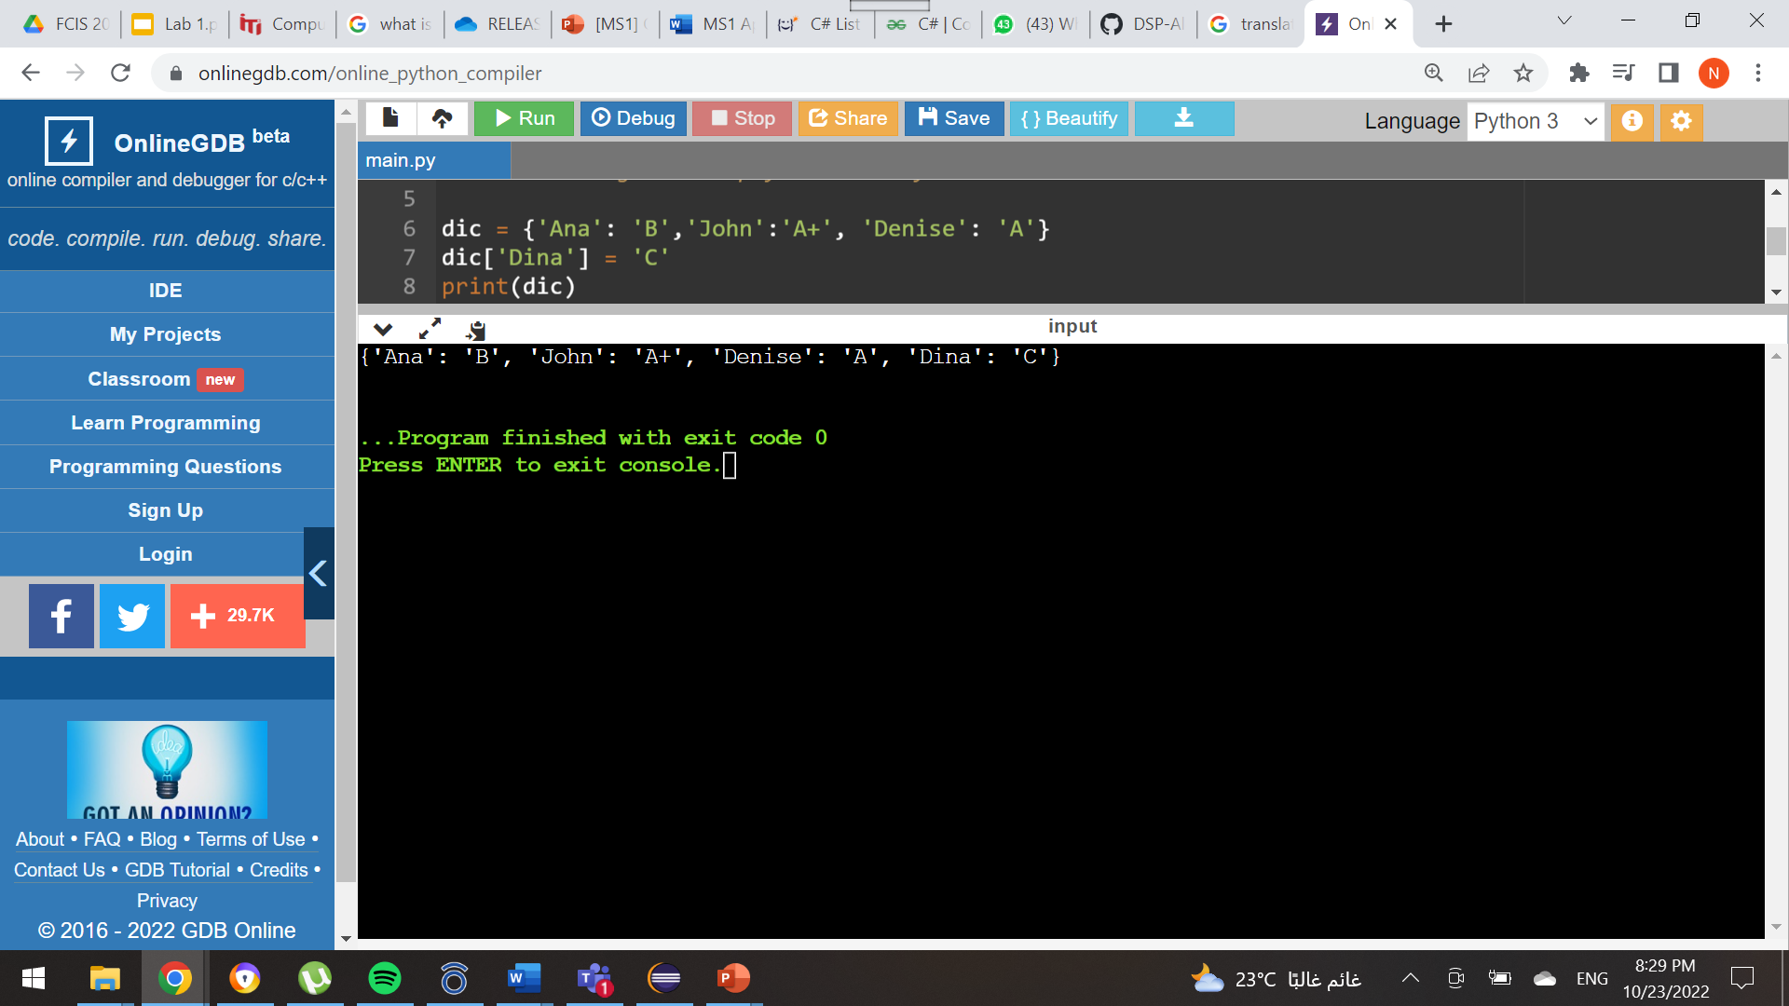
Dictionary
Note that:
A Key or a value can be of any type int, string, char, tuple, list ...etc.
Initialization:
Accessing values:
Checking the existence of a specific key:
Adding a new entry (Key-value pairs):

Slide 5
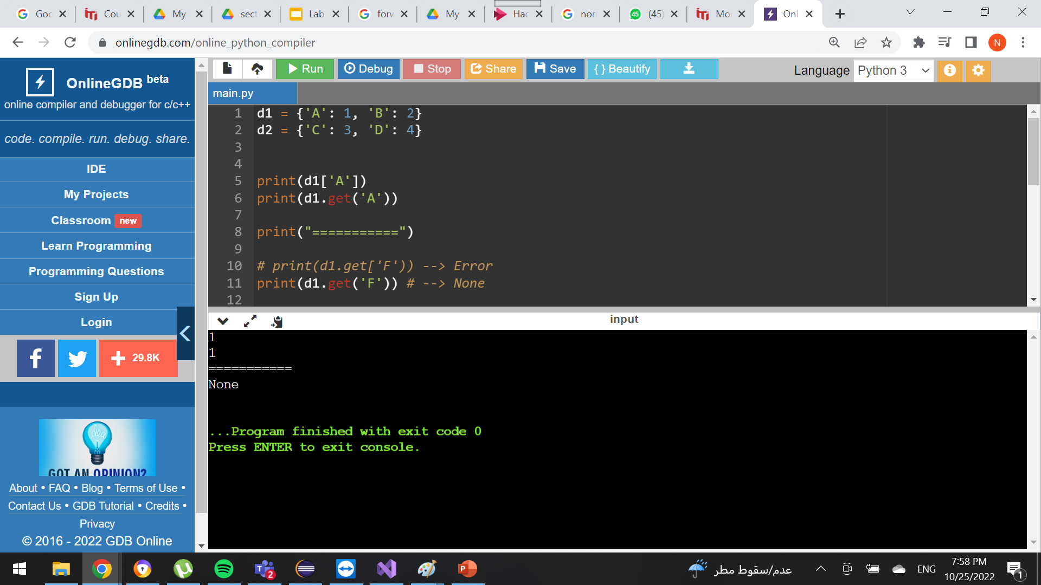
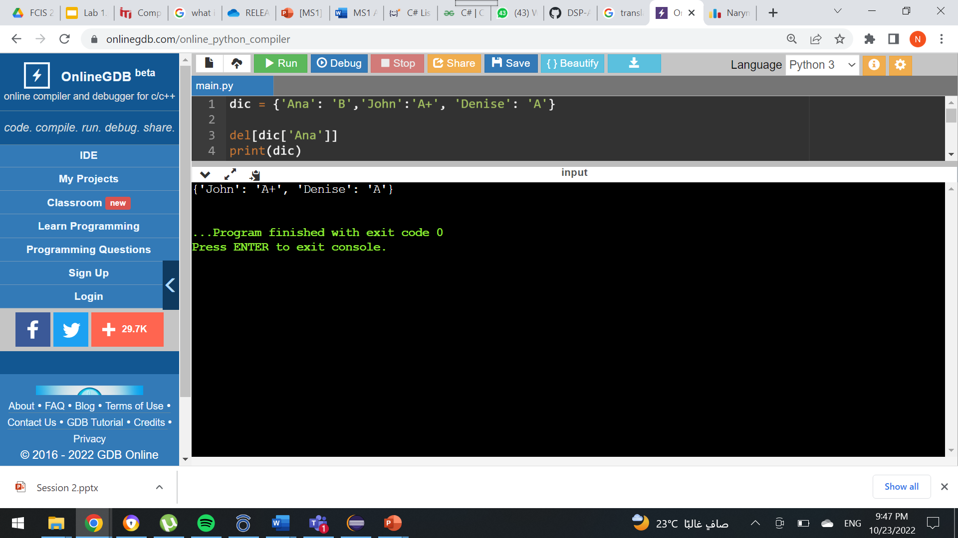
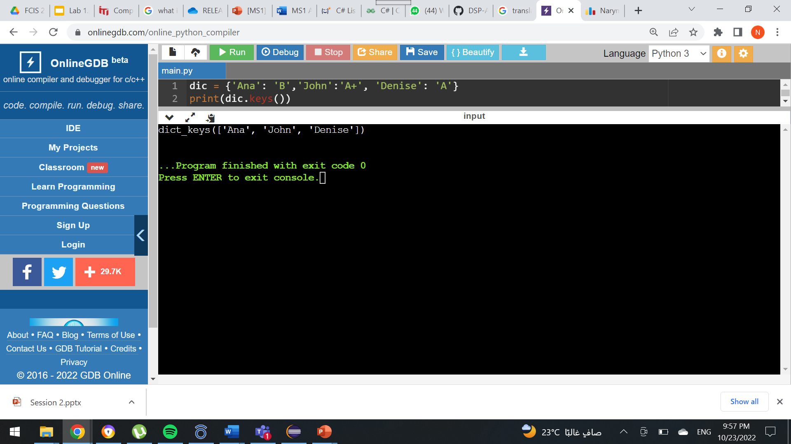

Dictionary functions
. get ( )
del[ dictionary_name[key] ]
. keys()
. values( )

Slide 6
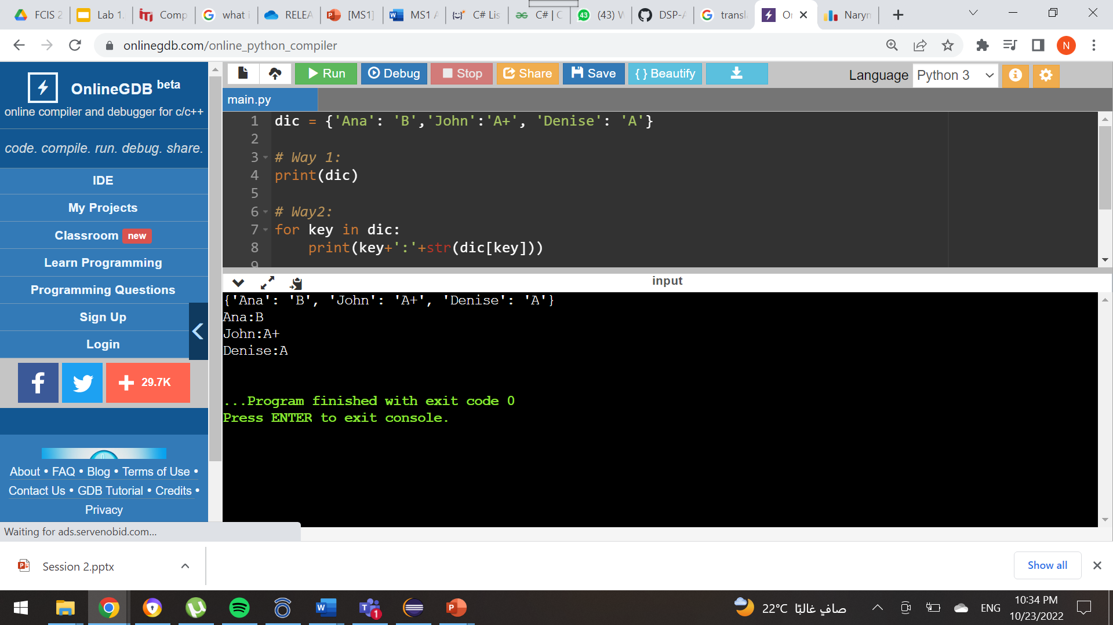
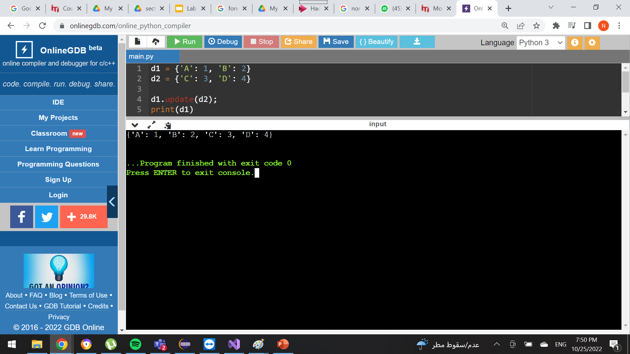
Dictionary functions
How to print a dictionary?
How to concatenate two dictionaries?

Slide 7
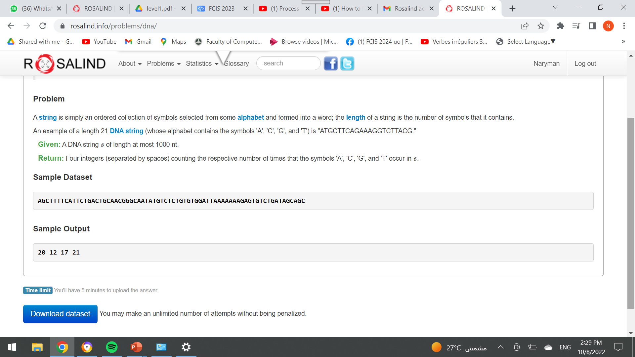
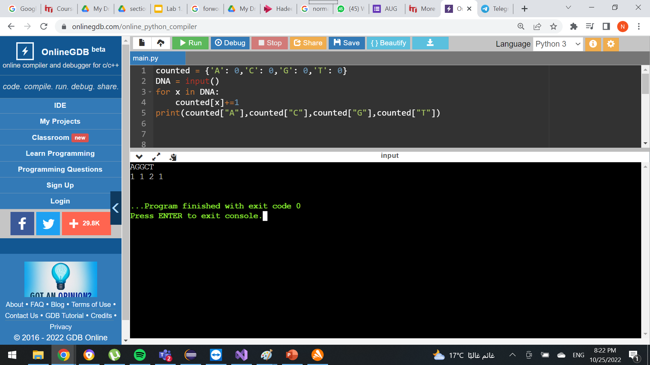
Task 1

Slide 8
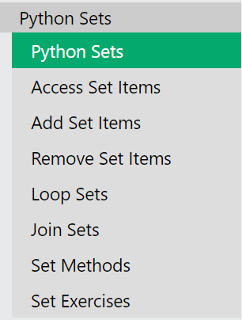
Sets
Click to go to the content

Slide 9
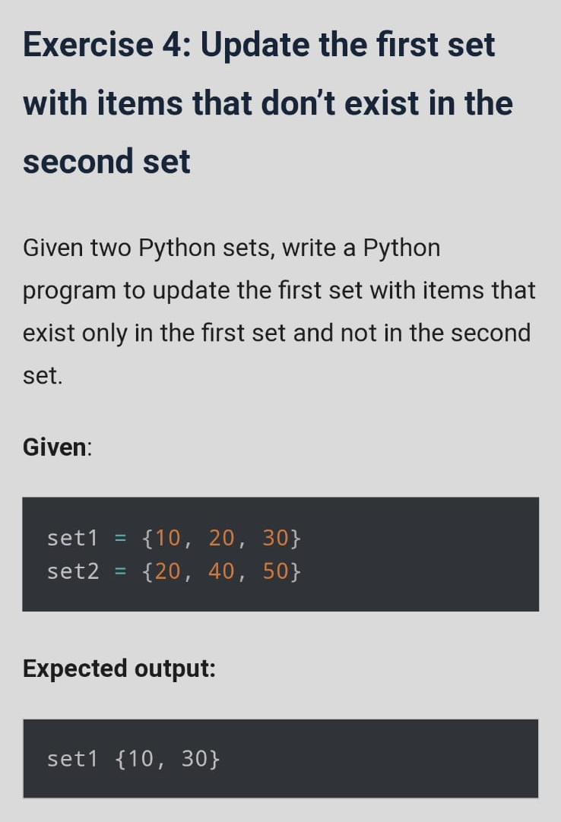
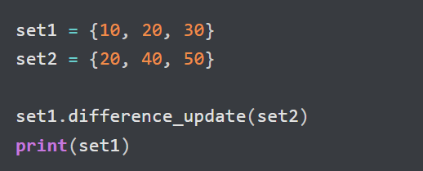
Task 2
Solution

Slide 10
Break
10 minutes break

Slide 11
Thank you
References:
https://www.w3schools.com/python/python_sets.asp
https://pynative.com/python-set-exercise-with-solutions/
Naryman Ahmed
narymanahmed@gmail.com

